Slide 1
Metadata Standards
EDS213 - Databases & Data Management (Week 7)
Renata Curty
Research Data Services, UCSB Library
rds@library.ucsb.edu

Slide 2

Learning Objectives
Understand the role of metadata in facilitating the management, discovery, interoperability, and reuse of digital resources and research data.
Recognize the importance of adhering to domain-specific metadata standards and determining which standard should be used.
Identify metadata standards relevant to environmental sciences research.
Notes:
Week 7 - documenting things

Slide 3
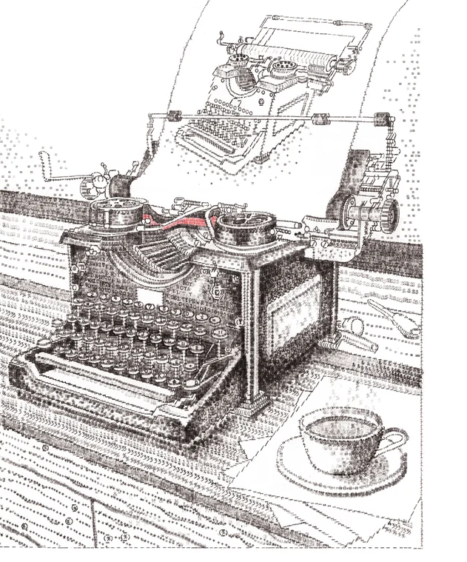
As meta as it can be
self referential
https://www.jamescookartworkshop.com
Notes:
Greek Prefix: More comprehensive, transcending, beyond

Slide 4
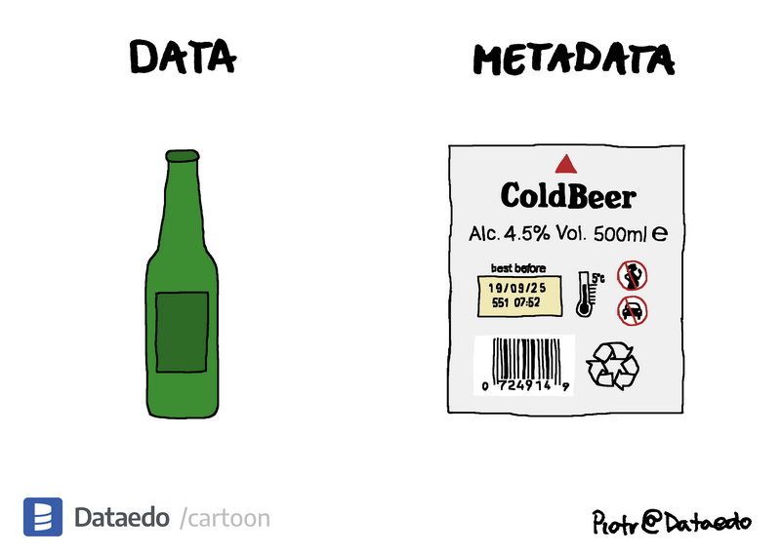
Metadata
“data about data”
Summarizes basic information, data attributes and descriptors that can make tracking and working with datasets possible and easier.

Slide 5
Metadata
Descriptors for digital objects help in understanding what they are, where to find them, how to access them, and more.
Depends on digital object being described.
The depth and breadth of metadata differ based on their purpose and system requirements.
Comprehensive metadata ∝ reuse potential

Slide 6
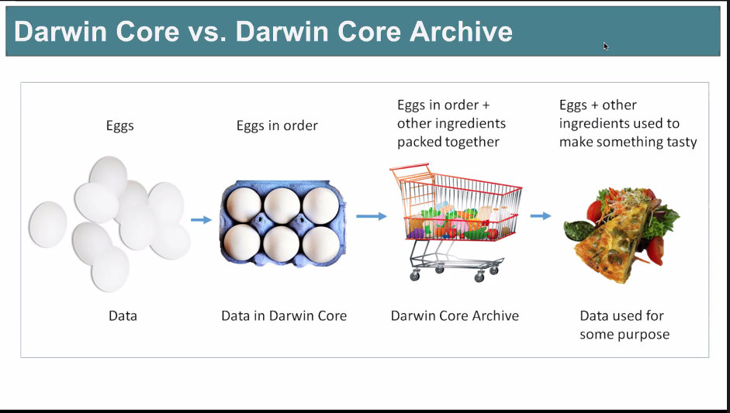
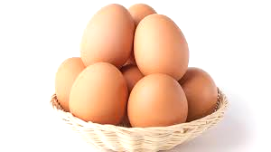
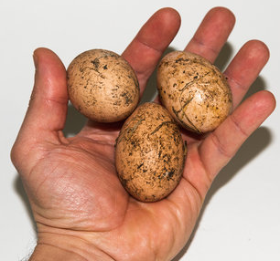
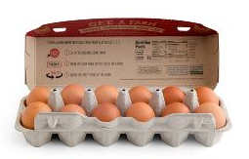
From data to research deliverables
Collected/
generated/
located
Arranged, cleaned, labelled and with provenance info
Other related items packed together
You may combine them to make something tasty
Research Deliverables (papers, reports, inform ne policies)
Data
Data +
Rich Metadata
Data Repository
(Software/Code)

Slide 7
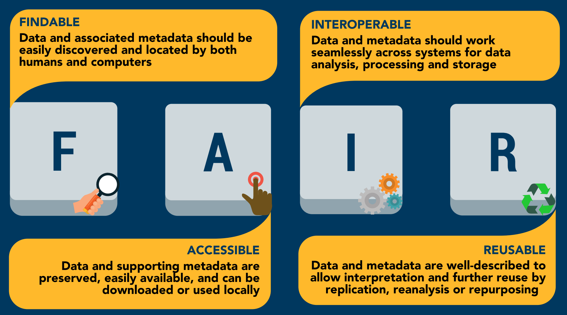
FAIR Data
Wilkinson, M. D., Dumontier, M., Aalbersberg, I. J., Appleton, G., Axton, M., Baak, A., Blomberg, N., Boiten, J. W., da Silva Santos, L. B., Bourne, P. E., Bouwman, J., Brookes, A. J., Clark, T., Crosas, M., Dillo, I., Dumon, O., Edmunds, S., Evelo, C. T., Finkers, R., Gonzalez-Beltran, A., … Mons, B. (2016). The FAIR Guiding Principles for scientific data management and stewardship. Scientific data, 3, 160018. https://doi.org/10.1038/sdata.2016.18
Notes:
Note that metadata is always included

Slide 8
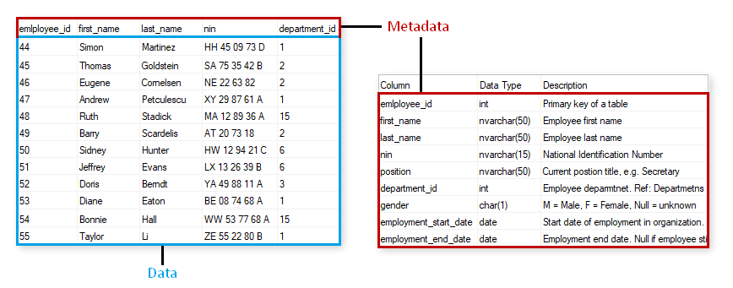
Metadata?

Slide 9
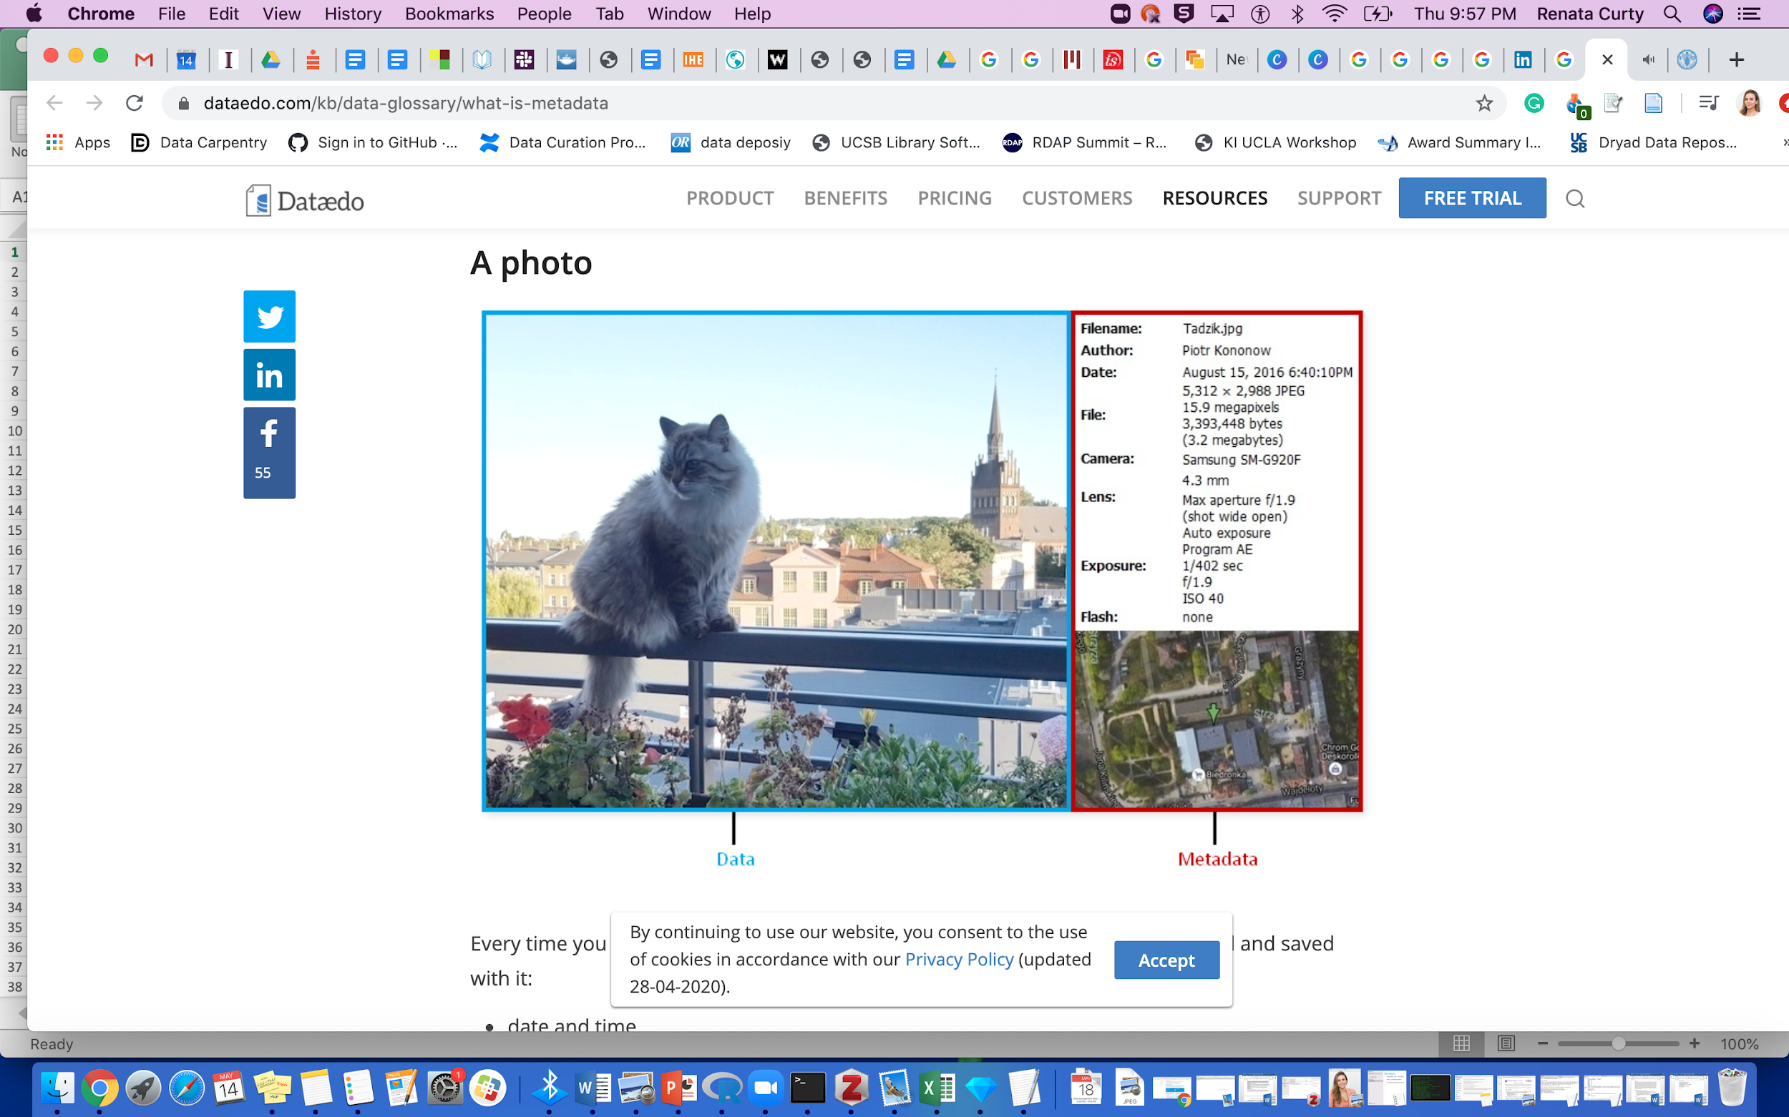
Metadata?

Slide 10
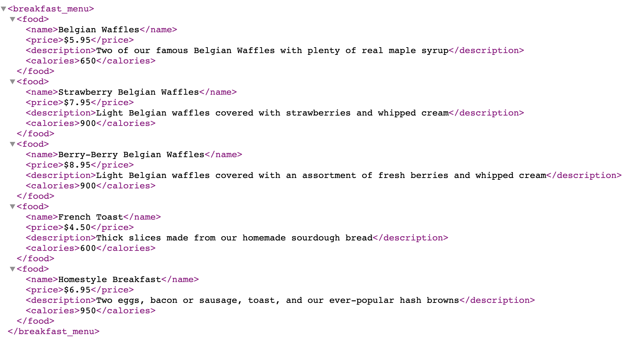
Metadata?

Slide 11
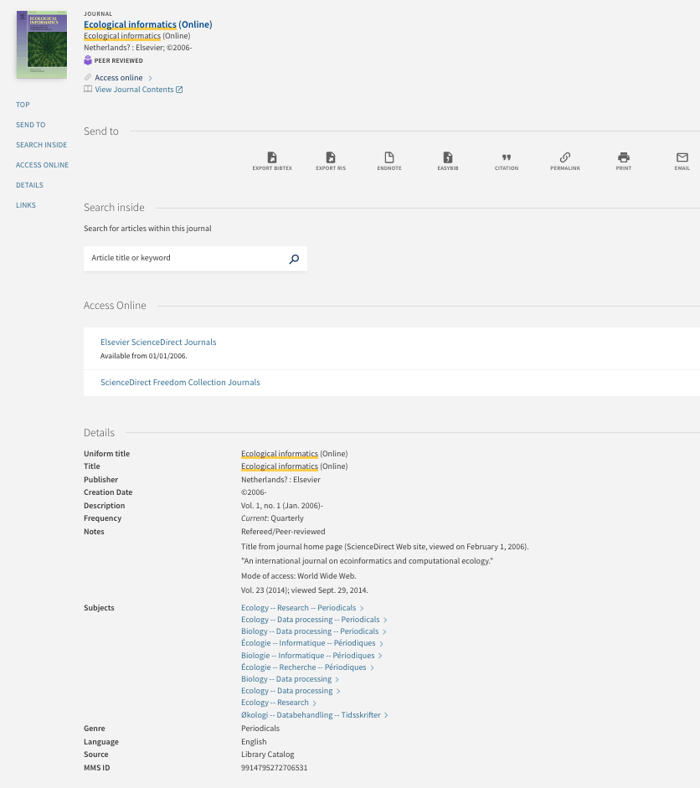
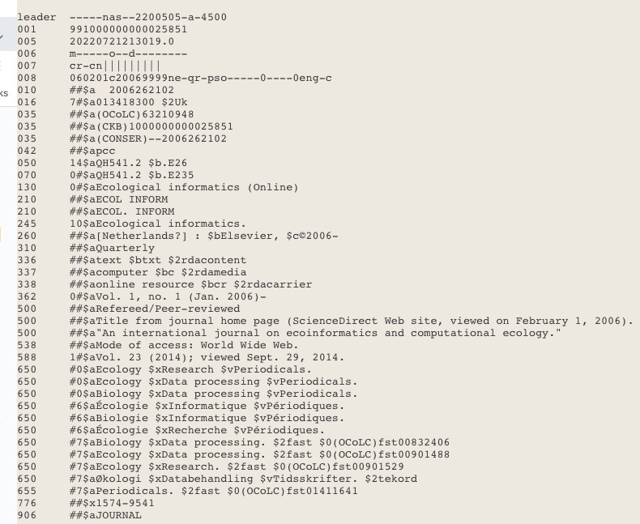
Metadata?

Slide 12
All metadata…but what about standard?
Human-readable/ Manually Created
Not as easy for machines to parse
Machine & Human Readable. Generic. No specific standard.
Automatically Created
Both Machine and Human Readable
Behind the “scenes”
Both Human and Machine Readable following a convention/standard
Notes:
In order to metadata be useful for data discovery and re-use, computers must be able to extract information from them. The metadata should be standardized.

Slide 13
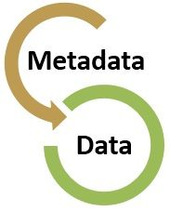
Metadata Best Practices
Keep data entry consistent
Define the parameters and their units
Explain formats for dates, time, geographic coordinates
Define any coded values and qualifying values
Describe quality flags
Define missing values
Give preference to established metadata standards
Notes:
ISO example (gregorian - day, month, year)
Quality flags - estimated data points

Slide 14
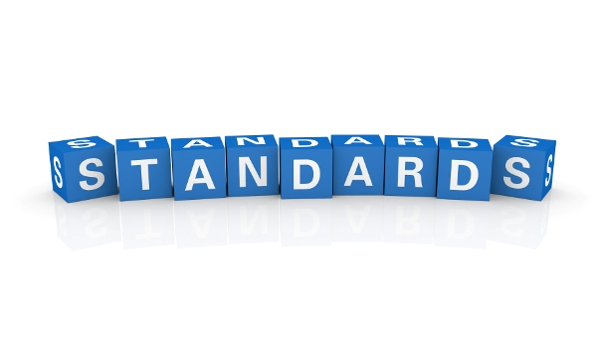
Metadata Standard
Establishes a common way of structuring and understanding data, and includes principles and implementation issues for utilizing the standard.
Provides a structure to describe and retrieve data!
Common terms to allow consistency between records
Common structure to quickly locate components/items
Reliable and predictable format for computer interpretation
A uniform summary description of the dataset

Slide 15
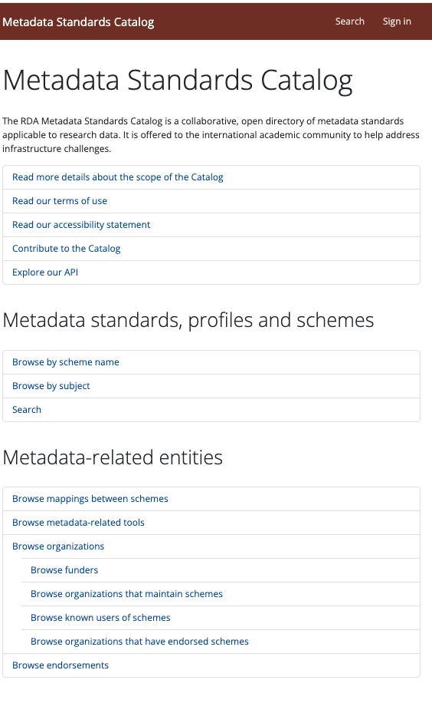
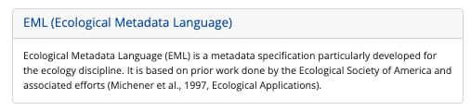
Which Metadata Standard?
https://rdamsc.bath.ac.uk

Slide 16
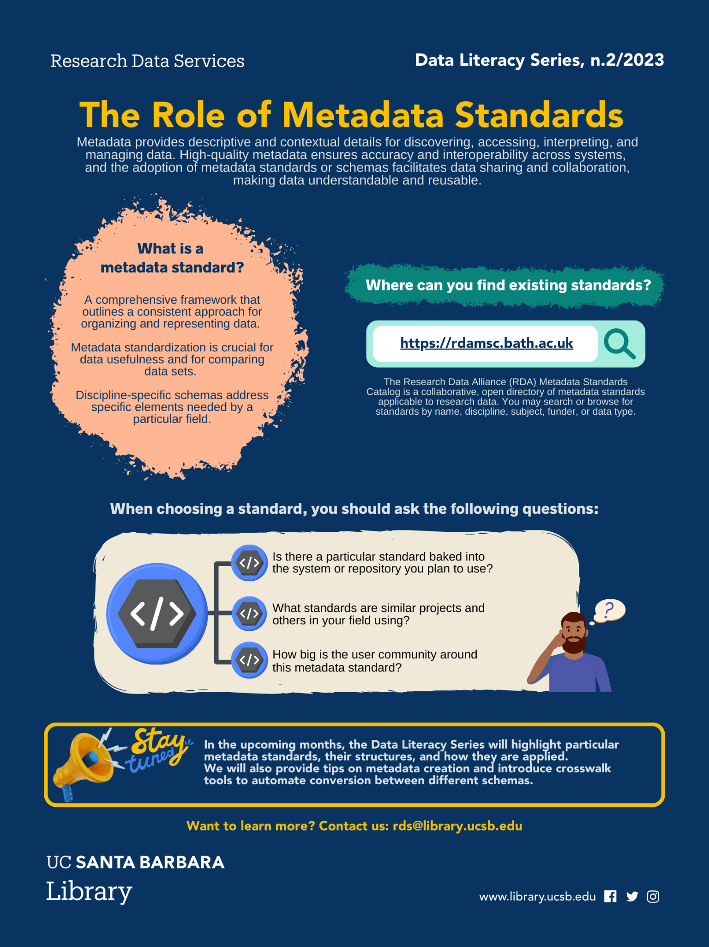
Choosing a Metadata Standard
Key questions:
Is there a particular standard baked into the system or repository you plan to use?
What standards are similar projects and others in your field using?
How big is the user community around this metadata standard?
Metadata Standards Catalog:
https://rdamsc.bath.ac.uk
https://perma.cc/A5PN-YF7Z

Slide 17
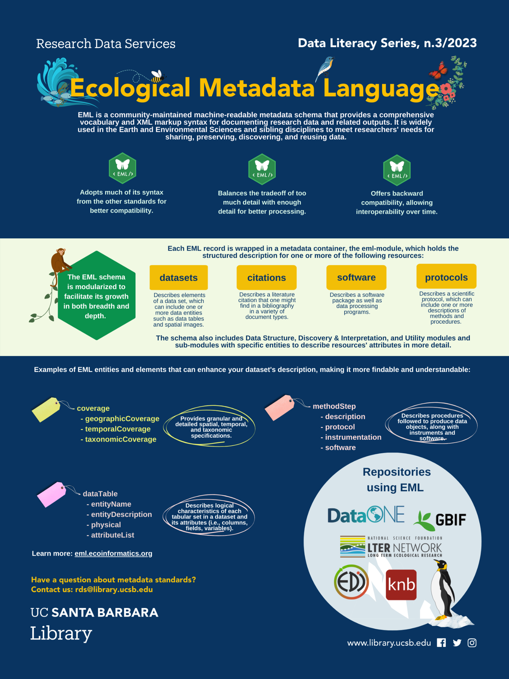
EML
Current version EML 2.2.0
Developed at NCEAS (Mat Jones)
Compatible with other standards (DCMI, CSDGM/FGDC, ISO19115 )
A “dialect” for XML
Modular
Detailed structure
Strong Typing
Uses tags aligned with the requirements and needs from the ecology and environmental community
Used by some of the most relevant data repositories in the field
https://eml.ecoinformatics.org/
https://perma.cc/E2TP-GXSX

Slide 18
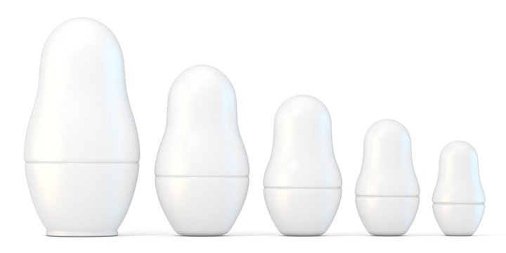

EML in XML
EML Record
Dataset
Data Table
Attribute
List
Attribute

Slide 19
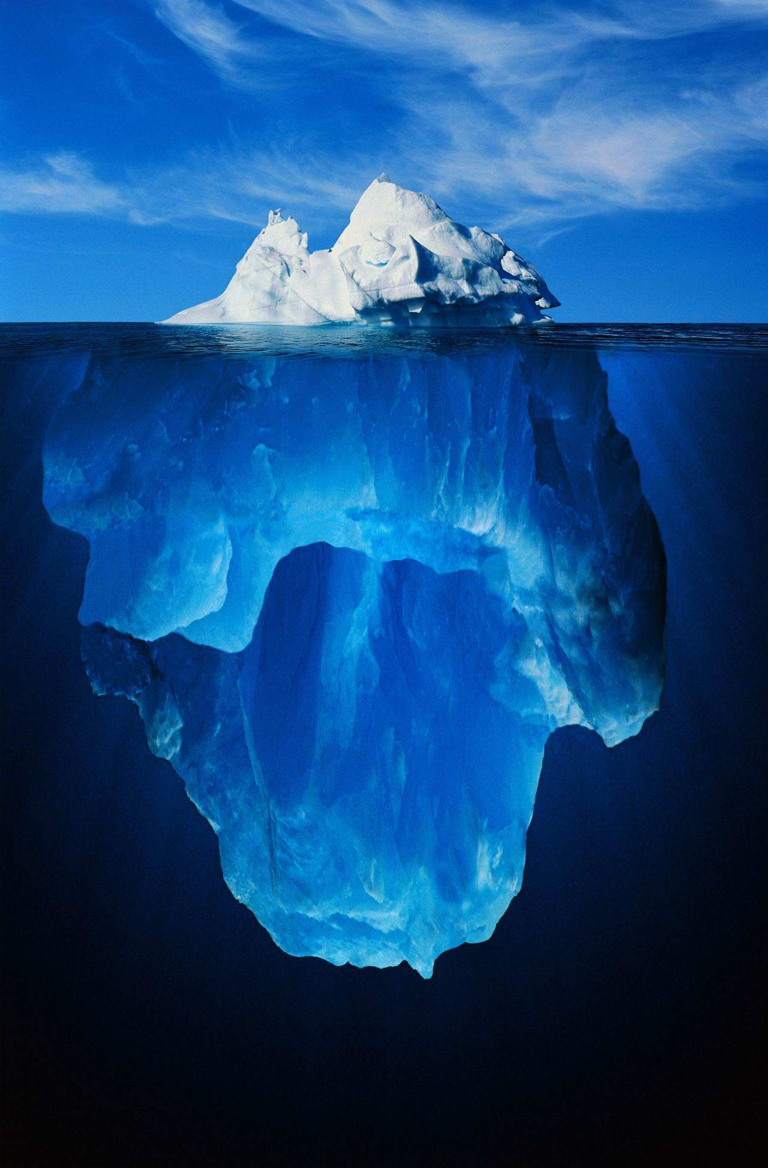
A good enough EML record
- eml
- dataset
- title*
- creator(s)*
- publisher
- pubDate
- keywords
- abstract
- intellectualRights
- contact*
- methods
- coverage (e.g., geographic/temporal/taxonomic)
- dataTable
- entityName
- entityDescription
- physical
- attributeList
*A minimum valid record (but not as useful)
Notes:
EML records can be started simply with sufficient information to cite and find at a basic level a dataset, and then additional detail added over time. Generally speaking there are 12 properties and some sub-properties we would describe for a specific dataset.

Slide 20
Creating an EML Record
Simple text editor (e.g., Atom) - painful! Only recommended for small edits. Not for creating a whole record.
EzEML (EDI Web Form) - GUI for non-tech people, useful tool, but can be time consuming, lots of clicks!
An EML R package for you’all data-savys (Example)
If you become a data manager and need to create multiple records in a bulk, there is a Excel to EML option! Not worth it for one at a time!

Slide 21
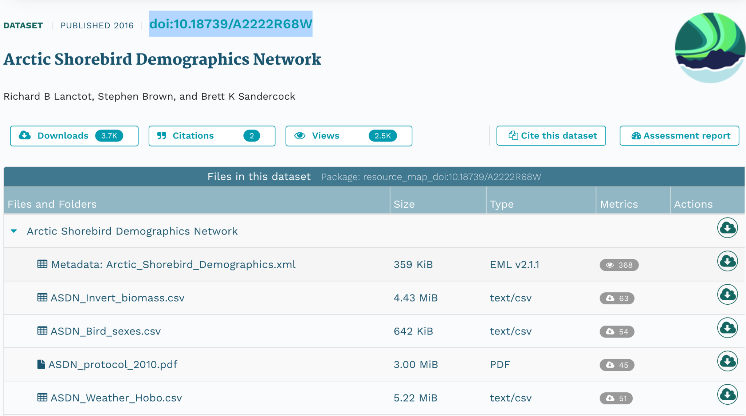
Remember the Shorebird dataset?
doi:10.18739/A2222R68W

Slide 22
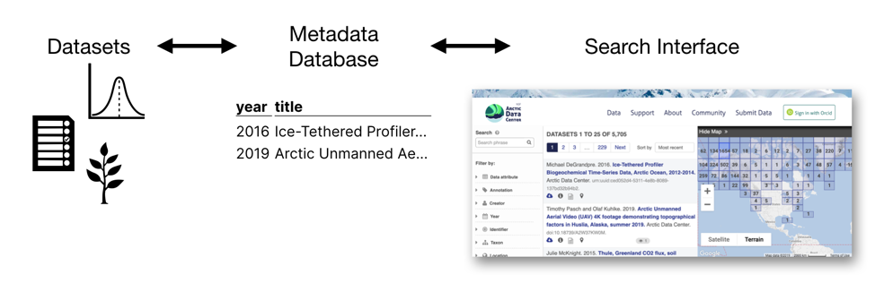
Bringing Data to the Surface
More attributes of data become visible and searchable, while also maintaining greater consistency
https://www.nceas.ucsb.edu/news/why-you-never-knew-how-much-you-needed-ecological-metadata-language
Notes:
Suppose you have a dataset on soil temperature, with EML you could assign predefined terms and units to an otherwise undocumented column, such as “Celsius.” With a structured metadata language like this, many metadata records can be combined into a single database, which allows for the creation of search interfaces for finding data.
The result is like a Google for data, allowing users to query their specific interests, such as “datasets with soil temperatures north of 50° latitude.
Dataone is a portal that provides access to data across multiple member repositories, supporting enhanced search and discovery of Earth and environmental data. Rich metadata and compliance with standards is key for this process.

Slide 23
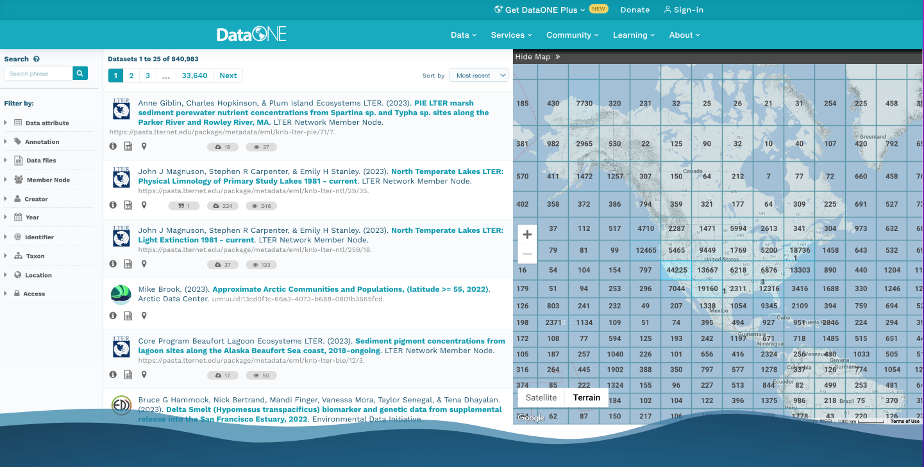
EML in Action https://search.dataone.org/data
Let’s try it!
Notes:
Example:
Water reservoir
Data Attributes: Organic Matter & PH
Geolocation

Slide 24
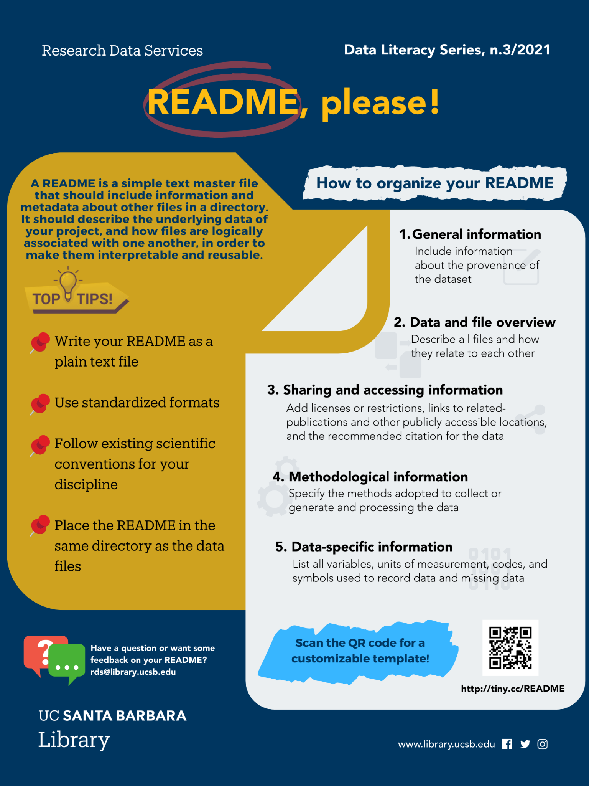
No Metadata Standard?
Generalist repository?
Record-level metadata
File-level metadata
What was measured?
What were the units of measure?
Who measured it?
When was it measured?
Where was it measured?
Which instruments were used?
How was it measured?
How is the data structured?
Why was the data collected?
Who should get credit for this data?
How can this data be reused?
What license governs the data?
https://perma.cc/A5PN-YF7Z
Notes:
–Greg
Mention: redundancy is not a bad thing.

Slide 25
Closing Thoughts
Both machine and human-readable metadata are needed to describe digital objects such as datasets
Without a standardized metadata format, each individual or organization may create and use their own metadata schema or structure. This lack of consistency makes it challenging to locate, compare, combine, or integrate datasets from different sources
Metadata standards like EML are instrumental for efficient data management, to promote interoperability and data discovery
Data scientists are expected to comply with metadata standards

